Slide 1

DFC MP
Wound Healing
Operational Definition
Last Updated 2026JAN13
Giselle Kolenic, SABER

Slide 2
Protocol Specified Wound Healing Endpoint
“Proportion of participants with complete wound healing by week 52, defined as complete wound closure where there is skin re-epithelialization without drainage or dressing requirements at two consecutive study visits 2 weeks apart. Infections of the index DFU and amputations of the limb associated with the index DFU are considered non-healers.”

Slide 3
Wound Healing Operational Definition – Per Protocol
DFUs are assessed at each visit and this assessment is captured in the wound evaluation case report form (CRF) and in other forms (e.g., Amputation CRF).
At each visit, information from the wound evaluation form (and other forms) can be used to derive values for the wound healing status outcome.
The primary endpoint for the MP is wound healing status at week 52 (Visit 15), but the wound healing status can be determined for each participant at each time point to meet the needs of study investigators.
  EX: Wound healing by 12 weeks

Slide 4
Wound Healing Operational Definition – Per Protocol
The following slides provide a guide on how to operationalize the wound healing status endpoint at each study visit, including week 52 (Visit 15).
Wound healing operational definition categories
  Healed
  Not healed
  Missing
    Due to missed study visit
    Due to not enough information to determine healing status

Slide 5
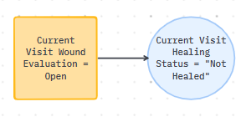
Wound Evaluation Form → Open Wound
If the wound evaluation form indicates an open wound, the derived wound healing status variable for that visit takes the value “Not Healed”

Slide 6
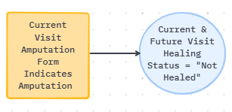
CRFs → Amputation
If an amputation is indicated at the current visit, the derived wound healing status variable for that visit takes the value “Not Healed”
The derived wound healing status variable for all future visits takes the value “Not Healed”

Slide 7
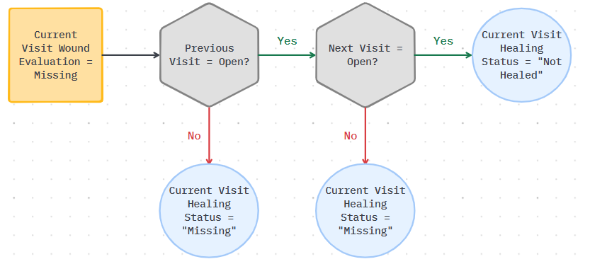
Wound Evaluation Form → Missing

Slide 8
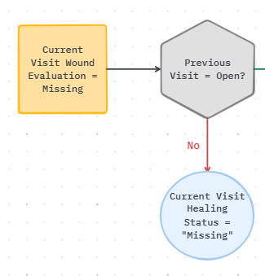
Wound Evaluation Form → Missing
If the wound evaluation form is missing for a visit
  AND the previous visit wound evaluation form does not indicate an open wound
  then the derived wound healing status variable for that missing visit takes the value “Missing”

Slide 9
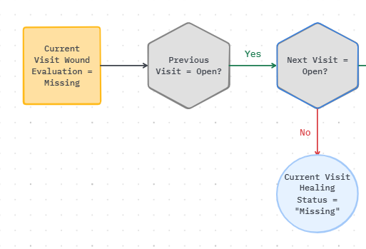
Wound Evaluation Form → Missing
If the wound evaluation form is missing for a visit
  AND the previous visit wound evaluation form indicated an open wound
  AND the next visit wound evaluation form does not an open wound
  then the derived wound healing status variable for that missing visit takes the value “Missing”

Slide 10
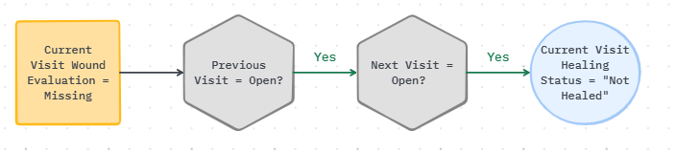
Wound Evaluation Form → Missing
If the wound evaluation form is missing for a visit
  AND the previous visit wound evaluation form indicated an open wound
  AND the next visit wound evaluation form indicates an open wound
  then the derived wound healing status variable for that missing visit takes the value “Not Healed”

Slide 11
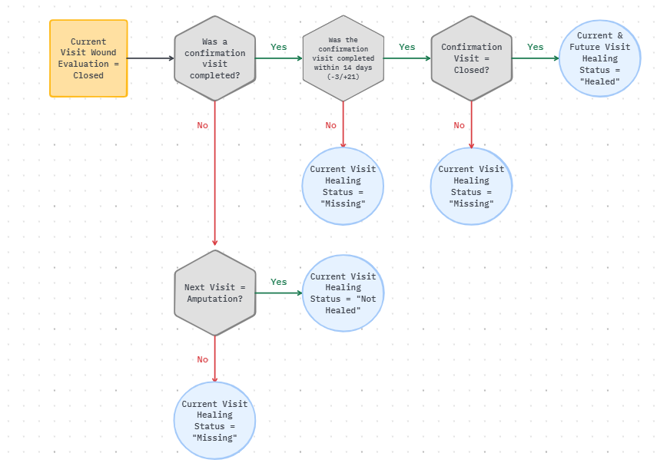
Wound Evaluation → Closed Wound

Slide 12
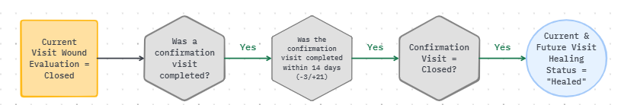
Wound Evaluation → Closed Wound
If the wound evaluation form indicates a closed wound
  AND a wound confirmation visit was completed
  AND the wound confirmation visit was completed within 14 days (-3/+21)
  AND the wound confirmation visit confirmed the closed wound
  then the derived wound healing status variable for that visit and future visits takes the value “Healed”

Slide 13
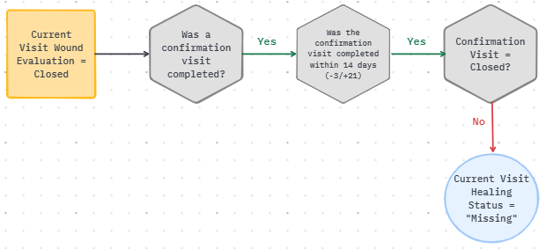
Wound Evaluation → Closed Wound
If the wound evaluation form indicates a closed wound
  AND a wound confirmation visit was completed
  AND the wound confirmation visit was completed within 14 days (-3/+21)
  AND the wound confirmation visit DID NOT CONFIRM the closed wound
  then the derived wound healing status variable for that visit takes the value “Missing”

Slide 14
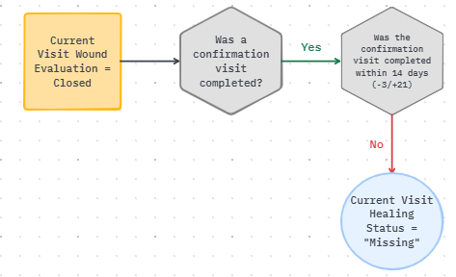
Wound Evaluation → Closed Wound
If the wound evaluation form indicates a closed wound
  AND a wound confirmation visit was completed
  AND the wound confirmation visit WAS NOT completed within 14 days (-3/+21)
  then the derived wound healing status variable for that visit takes the value “Missing”

Slide 15
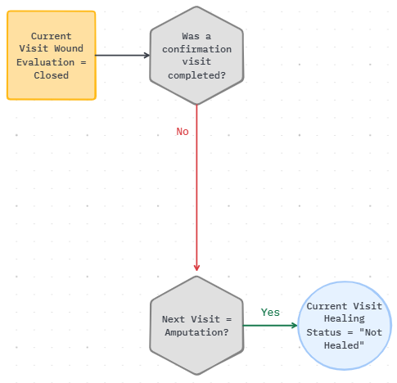
Wound Evaluation → Closed Wound
If the wound evaluation form indicates a closed wound
  AND a wound confirmation visit was not completed
  AND the next visit wound evaluation form indicates an amputation
  then the derived wound healing status variable for that visit takes the value “Not Healed”

Slide 16
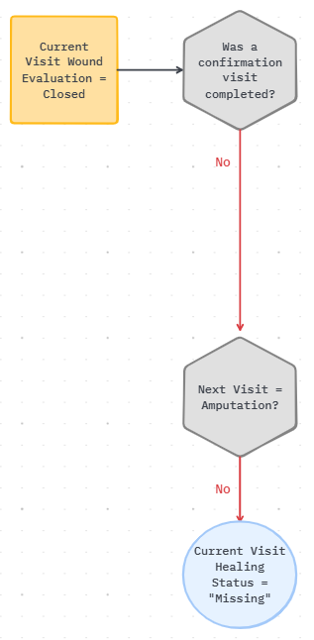
Wound Evaluation → Closed Wound
If the wound evaluation form indicates a closed wound
  AND a wound confirmation visit was not completed
  AND the next visit wound evaluation form does not indicate an amputation
  then the derived wound healing status variable for that visit takes the value “Missing”

Slide 17
Per Protocol Primary Wound Healing
Endpoint Visit 15 / Week 52
The primary healing status endpoint will be defined as follows:
  If a patient has a healed wound assessment at or before V15 which is confirmed 14 (-3/+21) days later, their primary endpoint is recorded as “healed” (regardless of intermittent missed visits)
  If a patient is withdrawn from the study early due to amputation, their primary endpoint is recorded as “not healed” (regardless of intermittent missed visits)
  If a patient has a V15 with an open wound at assessment, then their primary endpoint is recorded as “not healed” (regardless of intermittent missed visits)
  If a patient has a healed wound assessment at V15 which is confirmed but not within window (14 -3/+21 days), their primary endpoint is recorded as “missing”
  If a patient has a healed wound assessment at V15 which is not confirmed, their primary endpoint is recorded as “missing”
  If a patient is missing the V15 wound assessment and did not withdraw from the study early due to amputation, their primary endpoint is recorded as “missing”

Slide 18
Examples

Slide 19
Example 1
Wound Healing Status = “Not Healed” for Visits 1-15

Slide 20
Example 2
Wound Healing Status = “Not Healed” for every visit (V1-V15)
Visit 1 Diagram:
Visits 2-15 Diagram:

Slide 21
Example 3
Wound Healing Status = “Not Healed” for Visits 1-14
Wound Healing Status = “Missing” for Visit 15 (see diagram below)

Slide 22
Example 4
Wound Healing Status = “Not Healed” for Visits 1-15
See the diagram below for why V10 is “Not Healed” instead of “Missing”

Slide 23
Example 5
Wound Healing Status = “Not Healed” for Visits 1-3, 6-15
Wound Healing Status = “Missing” for Visits 4 & 5 (see diagrams below)
Visit 4
Visit 5

Slide 24
Example 6
Wound Healing Status = “Not Healed” for Visits 1-10
Wound Healing Status = “Healed” from Visits 11-15, assuming the confirmation visit was completed within 14 (-3/+21) days (see diagram below)

Slide 25
Example 7
Wound Healing Status = “Not Healed” for Visits 1-4, 6-15
Wound Healing Status = “Missing” for Visit 5 (see diagram below)

Slide 26
Example 8
Wound Healing Status = “Not Healed” for Visits 1-5
Wound Healing Status = “Missing” for Visits 6-8
Wound Healing Status = “Healed” from Visits 9-15, assuming the confirmation visit was completed within 14 (-3/+21) days
Diagram for Visit 2:

Slide 27
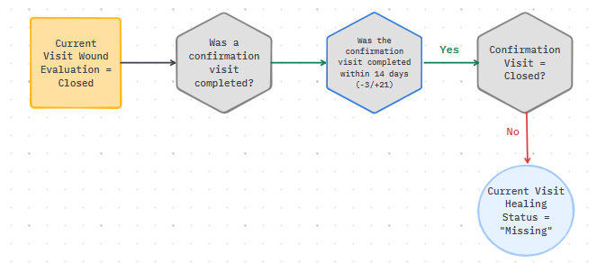
Example 9
Wound Healing Status = “Not Healed” for Visits 1-7, Visits 9-15
Wound Healing Status = “Missing” for Visit 8 (see diagram below)

Slide 28
Example 10
Wound Healing Status = “Not Healed” for Visits 1-15
See diagram for Visit 9 decision:

